Slide 1

COHORT EXECUTION WORKSPACE
ONROL
AI Video & Audio Generation
Mastering synthetic media pipelines. Learn to build high-converting presenter videos, generate rich voiceovers, compose jingles, and confidently detect synthetic tells.

Slide 2
SECTION 01
ONROL
From Static to Moving
Closing Module 1 by transitioning from media that sits perfectly still—text and images—to high-converting media that moves, explains, and speaks.

Slide 3

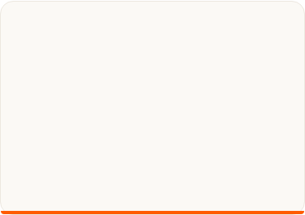
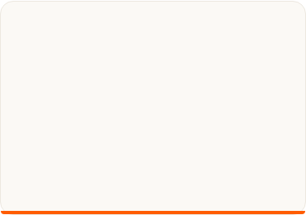




ORIENTATION: MOVING MEDIA
ONROL
The Three Toolkit Families
1. Video from Words
2. Presenters & Avatars
3. Audio Synthesis
Generating short, cinematic scenes directly from textual descriptions using predictive engines like Veo3 and Flow.
Creating voice-driven presenters or slide-based narrations cleanly and rapidly with HeyGen and Google Vids.
Synthesising professional, lifelike spoken voice overs, cloned tracks, or custom brand jingles via tools like Suno.

Slide 4
SECTION 02
ONROL
The Mechanics of Video Synthesis
Understanding how predictive diffusion models transition from single-frame static noise to temporally consistent moving visuals.

Slide 5
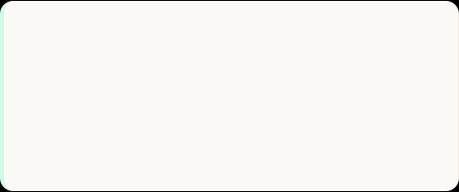
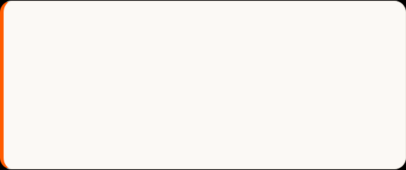
THE MECHANICS OF VIDEO
ONROL
Consistency Over Time & Scale
Temporal Consistency
The Computational Limit
A video is merely frames in quick succession. If generated frame-by-frame, they flicker. Advanced video generators predict pixels as a single connected sequence so objects hold their physical identity securely.
Because keeping a synthetic world consistent across time is heavily demanding, AI video clips are naturally short (4-5 seconds). Generalists plan ahead by combining short, highly controlled scenes.

Slide 6

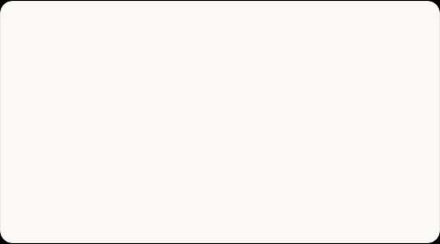
PROMPTING FOR VIDEO
ONROL
Describing Shots: Two Key Patterns
"A cup of coffee in a South Indian cafe..."
"A handcrafted leather bag slowly turned..."
"A steaming cup of filter coffee on a wooden table, gentle morning light through a window, slow camera push-in towards the cup, a hand placing a plate of medu vada beside it, warm and inviting mood, 5s."
"A handcrafted brown leather handbag resting on a marble surface, soft studio lighting, a woman’s hand slowly lifting the bag by its strap and turning it gently to show the premium stitching, 4s."

Slide 7
SECTION 03
ONROL
Avatars and Explainer Presenters
Bypassing slow studio production. Put highly realistic digital spokespeople on screen or generate beautifully narrated presentation slides.

Slide 8
AVATARS & PRESENTERS
ONROL
Spokespeople vs. Slide Explainers
HeyGen: Audio-Driven Avatars
Google Vids: Slide Explainers
Maps speech sounds to mouth shapes (visemes) on a digital face. Great for course intros or welcomes (e.g., Vidya Coaching Centre). Watch out: faces can look slightly steady; mouth moves but eyes remain neutral.
Turns outlines, documents, or slides into narrated process explainers or internal training decks. It features automatic slide layouts, visual transitions, and smooth, professional voiceovers.

Slide 9
SECTION 04
ONROL
The Audio Synthesis Layer
Generating professional speech narration, cloned voice metrics, and licensed-free musical scores from plain language parameters.

Slide 10
VOICE & MUSIC SYNTHESIS
ONROL
Unlocking Voice & Suno Music
The Prosody Challenge: Spoken AI excels at spelling but struggles with melody and stress. It is ideal for clear informational narration but less suited for deep emotional ranges.
Suno Jingle Creation: Generate complete songs with lyrics. Hindi example: "An upbeat, cheerful Hindi jingle, light percussion, catchy melody, festive Diwali garment store sale."
Zero Copyright Hassles: Create brand soundtracks without licensing fines or platform audio takedowns.
Write for the Ear: When generating voiceovers, use short sentences and strategic punctuation to signal natural breathing pauses to the speech engine.

Slide 11
SPOTTING SYNTHETIC MEDIA
ONROL
How to Spot Synthetic Tells
Media Format | Obvious AI Tells | The Root Mechanism Cause | Lasting Defense
Video | Flickering teeth, warped fingers, shimmery edges. | Approximate visual prediction instead of physical modeling. | Verify source origins.
Spoken Audio | Overly clean syllables, missing breaths, flat rhythm. | Predicting cadence directly from unannotated text. | Query who published it.
Avatars | Odd lip drift, static forehead, unblinking eyes. | Sound driving mouth shapes (visemes) on static meshes. | Confirm explicit consent.

Slide 12
SECTION 05
ONROL
Workspace Practice Challenges
Complete your Module 1 milestone. Move from passive orientation directly to shipping high-end generated video and audio.

Slide 13
PRACTICE WORKSPACE
ONROL
Your After-Class Practice Tasks
Task 1: Generate a short promo clip (Veo3): Write a detailed description naming Subject, Action, Setting, and Look. Keep motion extremely simple and smooth.
Task 2: Build an Avatar Intro (HeyGen): Write a friendly one-minute script introducing a real-world service or business. Use a standard tool-provided avatar (no fakes!).
Task 3: Compose an Original Jingle (Suno): Generate a short 15-second jingle. State the genre, language, specific instruments, and occasion clearly in the prompt.
Task 4: Critical Synthetic Sifting: Locate an AI video online. List three specific visual tells, and write a 1-sentence note explaining why each happened mechanically.

